Slide 1
SEAM’s ‘Storytelling Dialectical Method’ and How Appreciative Inquiry can be a Scientific Method of Organizational Development and Change
David M. Boje, Ph.D.
Regents Professor New Mexico State University
INTERNATIONAL CONFERENCE AND DOCTORAL CONSORTIUM
colloqueodc2016@iseor.com (‘ON ORGANIZATION DEVELOPMENT AND CHANGE’ 9-10 June, 2016 Lyon, France

Slide 2
Opener
There is no ‘action’ and no ‘research’ in current renditions of action research.
Why? Because ‘action research’ (AR) is not based on any sort of ‘action’ perspective, but rather is rooted in social constructivist standpoints, of gathering and sifting points of view (epistemically).
Remedy: To develop a dialectic of Action with Being, that is ontological, not just epistemic.

Slide 3
The ODC Storytelling Debate
Without DIALECTICS Appreciative Inquiry (AI) is one-sided, focusing exclusively on the positive stories, a vacuous ‘positivity’ approach lacking negative stories’ content, and thoroughly opposed to any sort of dialectical method of change.
Socio-Economic Approach to Management (SEAM), dialectically manages change by focusing on how in each negative (dysfunction) there is a human Subject and a Predicate of hidden costs that can become transmuted into a positive human potential and an organization value-added

Slide 4
My standpoint
SEAM dialectics emerges in a interplay transmuting negative into positive value added
Has Substance in Action & Being
Is thoroughly scientific and is Hegelian in its dialectic change management experiments
Is not Kantian nor Marxian in its dialectical approach.

Slide 5
By Contrast
Appreciative Inquiry (AI) defines problem-based ODC as inappropriate, and consigns them along with deconstruction and dialectic and critical theory to the language of deficiency, and therefore outside of a positive-based inquiry and change approach. Therefore ADDING DIALECTICS is needed.
AI is part of then general movement in positive social science (e.g. positive leadership, positive psychology, positive organizational behavior, positive change management).

Slide 6
Where Dysfunctions come from?
SEAM-STORYTELLING
TFW VIRUS
TAYLORISM
FAYOLISM
WEBERISM
STORYTELLING DYSFUNCTIONS
STORYTELLING Behaviors
STORYTELLING Hidden Costs
STORYTELLING Structures

Slide 7
Stage 1 on 4
Stage One ‘Differentiating Negatives from Positives: SEAM begins simply by distinguishing positive and negative, dysfunctions, and value-added behaviors and structures, and showing the dysfunctions are hidden form management information systems (balance sheets, income statements, standard reports), and therefore off the radar.
Stories of negative (dysfunctions) are collected in preparation for feedback session, called the Mirror Effect meeting.

Slide 8
Stage 2 of 4
Stage Two ‘Turning Negatives into Positives’: In Stage Two of the dialectical storytelling, the theme of how to transform dysfunctions into positive developments of human potential, occurs.
SEAM pursues three axes. Axis A (Cyclical Improvement Process) is a series of three or more Diagnostic-Project-Implementation-Evaluation (DPIE) interventions, each rooted in a meeting with management where consultants present weeks, often months of observations and interviews about apparent dysfunctions and associated hidden costs.
The principle is ‘Every Organization System is Perfectly Designed to Get the Results it Gets’

Slide 9
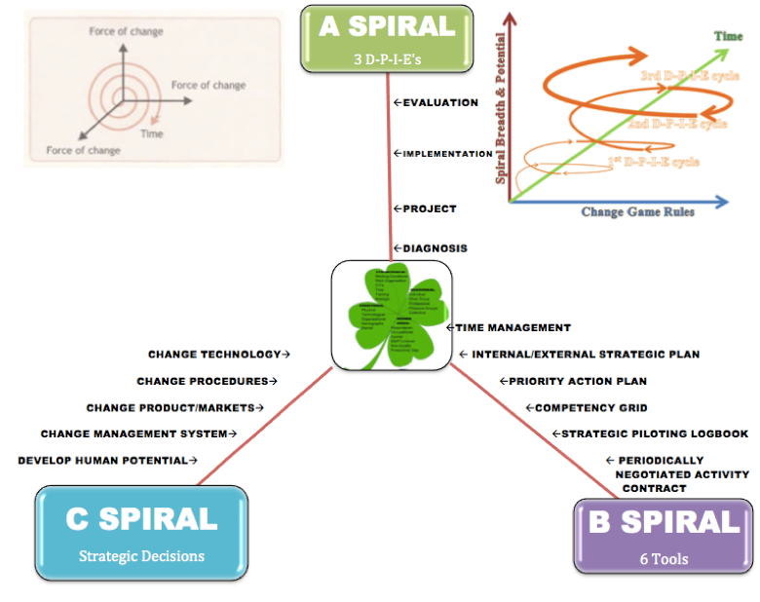

Slide 10
Stage 3 of 4
Stage Three ‘Unity of Negative with Positive’: There is a ‘restorying’ of the relationship of negative and positive, to establish a unity of human Subject with the Object dysfunctional processes.
The ego in previous stages often identifies or sees disparity between its own self and the substantive dysfunctions (negative).
The dialectical storytelling principle is the dysfunction, i.e. the negative is linked to the Self, and the DPIE and the Tools training (Axes A & B) are enacted to set the context of Action for positive socioeconomic empowerment by horizontal and vertical teams (Horivert) to start DPIE interventions.

Slide 11
Stage 4 of 4
Stage Four ‘Spirit Mediations’: Spirit in Hegel means ‘Reason’ and development of systems of inquiry into Scientific Method; Spirit does not mean spirituality or religion.
In Stage Four, the storytelling dialectic is about Spirit mediations, that spread out to know the organizational processes (structures & behaviors) and delve into the financial and economic stem-roots, such as excess salary, overtime, over-consumption, non-production, non-creation of potential, & risks).

Slide 12
Alpha, Beta, & Gamma Negativity
Alpha Negativity: First type is a negative that fails to account for the positive within some negative content.
In its Alpha Negativity, AI fails to see the ‘negative’ in its own process as a shadow side …
A good example is Appreciative Inquiry (AI), which pursues only positive stories within organization content and its diagnosis and intervention, but fails to see that the negative story has its positive aspects.

Slide 13
BETA NEGATIVITY
SEAM is doing 2nd type of negative, where each negative (each dysfunction) has a movement of positive content (possible ways to produce value-added spaces, times, structures, behaviors, etc.) when considered in the whole process or System of negative (dysfunctions) and positive reclaiming of hidden costs to produce untapped revenue potential from untapped human resource development, technology investments, structural and behavioral changes, value added time management, strategic implementation, and so on.

Slide 14
GAMMA NEGATIVITY
This third type of negative, Hegel (1807/1977: p. 36) calls “ratiocinative thinking.” It is defined here as a skilled and methodological process of Reasoning in which there is a back-and-forth rhythm
Spirit’s[Reason’s] movement of meter and accent between positive and negative.
It is this rhythm aspect of Hegel’s dialectic, its working its self-movement out in space, time, and matter (to be more accurate, in spacetimemattering that is inseparability) that we want to focus on here.

Slide 15
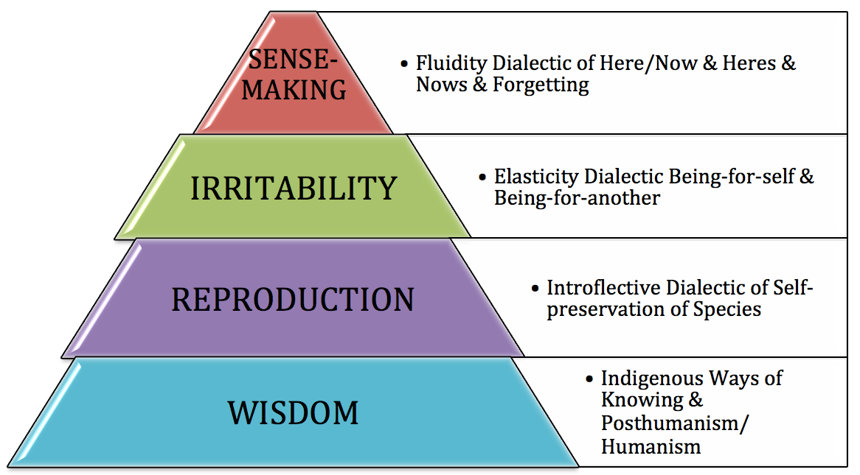
Dialectical Storytelling Model

Slide 16
SOCIO-ECONOMIC DIALECTIC STORYTELLING
“Performance is not the result of putting together resources (things); it’s the result of dynamic historical movement” [Savall in Boje 2011:383]
“An assemblage is migrative, iterant, in movement whereas a network is ties, connections that recur, that pattern being more stable” (IBID.: p. 384).
“Agency is not just human, but the configurative assemblage of materiality has energy --- ‘vibrant energy’ (IBID.: p. 384).
We do not find an assemblage process, complete, in form, but it is of different places, times, etc.

Slide 17
Main Contribution
The ways in which AI and SEAM are put in relation to one another via dialectical and quantum storytelling

Slide 18
Questions
Contact info: davidboje@gmail.com
David Boje
http://davidboje.com to find the slides and paper

